Slide 1
Recurrent Neural Networks
Introduction to memory cells
Gene Olafsen

Slide 2
overview
Recurrent Neural Networks (RNN)are a class of neural networks that can predict the future...
The idea behind RNNs is to make use of sequential information. In a traditional neural network it is assumed that all inputs (and outputs) are independent of each other. But for many tasks that approach is not best. If you want to predict the next word in a sentence you better know which words came before it.
RNNs are called recurrent because they perform the same task for every element of a sequence, with the output being depended on the previous computations.
For certain sequential machine learning tasks, such as speech recognition, RNNs are reaching levels of predictive accuracy, that no other algorithm can match.

Slide 3
Class of RNN problems
Analyze time series data- stock prices
Anticipate trajectories- autonomous driving
Natural language processing- Siri, Google Voice
Sentiment Analysis- document, audio input

Slide 4
Creative tasks
RNN ability to predict the next 'state' permits a certain level of 'creativity'
Google Magenta: composes melodies
https://cdn2.vox-cdn.com/uploads/chorus_asset/file/6577761/Google_-_Magenta_music_sample.0.mp3
Generate sentences
"Why do what that day," replied Natasha, and wishing to himself the fact the princess, Princess Mary was easier, fed in had oftened him. Pierre aking his soul came to the packs and drove up his father-in-law women.
Image Captions
https://arxiv.org/pdf/1411.4555v2.pdf

Slide 5
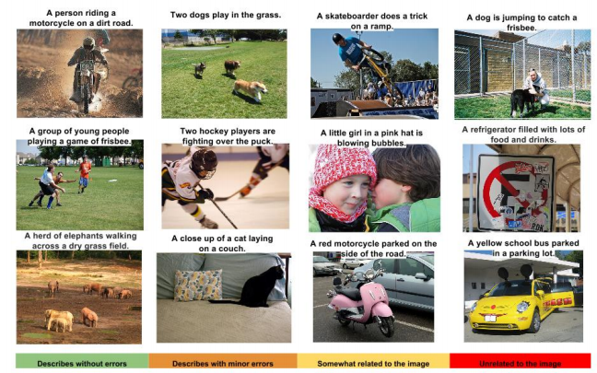
Image captions

Slide 6
RNN problems and solutions
Problems faced by RNNs:
Vanishing/Exploding Gradients
Solutions to help alleviate these issues:
LSTM (Long Short-Term Memory)
GRU (Gated Recurrent Unit)

Slide 7
Memory cell
Memory Cell: That part of a neural network which preserves state across time steps.

Slide 8
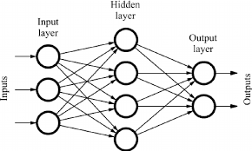
feedforward Network Review
A feedforward network is the network topology that has been covered up to this point.
Activations flow in one direction- from the input layer to the output layer.

Slide 9
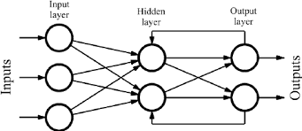
RNN is Different
Recurrent Neural Networks are similar to feedforward neural networks, except they also have connections point backward.

Slide 10
Single recurrent neuron
Y
The simplest RNN contains a single neuron.
The neuron receives input(s).
The neuron produces an output.
The output is sent back to 'itself'.
Σ
X

Slide 11
Unrolling the network through time
Y
(t-2)
Y
(t-1)
Y
(t)
A recurrent neuron receives inputs from time 't' as well as its own output from the previous step 't-1'
This example shows the network unrolled into a 3 layer neural network.
Σ
Σ
Σ
X
(t-2)
X
(t-1)
X (t)
TIME

Slide 12
RNN weights
Each recurrent neuron has two set of weights:
A weight for the inputs at X(t)
A weight for the inputs at the previous time step X(t-1)

Slide 13
Rnn activation function
Many researchers prefer to use a (tanh) hyperbolic tangent activation function (over ReLU) for RNNs.
Refer to:
"Dropout Improves Recurrent Neural Networks for Handwriting Recognition"
"A Simple Way to Initialize Recurrent Networks of Rectified Linear Units"

Slide 14
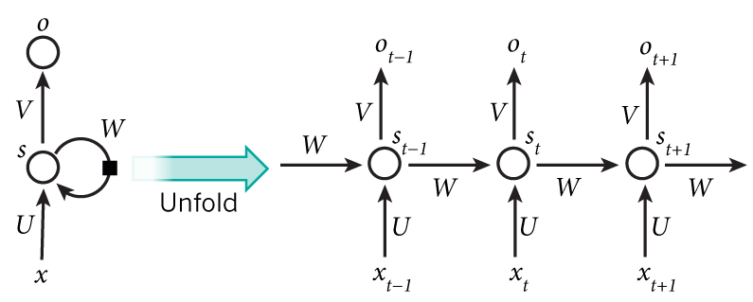
Unrolled showing variables

Slide 15
Variables Defined
X(sub)t is the input at time step t. For example, x1 could be a one-hot vector corresponding to the second word of a sentence.
s(sub)t is the hidden state at time step t. It’s the “memory” of the network.
Where s(sub)t is calculated based on the previous hidden state and the input at the current step.
o(sub)t is the output at step t. For example, if we wanted to predict the next word in a sentence it would be a vector of probabilities across our vocabulary.

Slide 16
Shared parameters
Unlike a traditional deep neural network, which uses different parameters at each layer, a RNN shares the same parameters (U, V, W above) across all steps. This reflects the fact that we are performing the same task at each step, just with different inputs. This greatly reduces the total number of parameters needed to lean.

Slide 17
RNN sequences
Sequence to Sequence
Simultaneously take a sequence of inputs and produce a sequence of outputs.
Stock price prediction.
Sequence to Vector (Encoder)
Feed a sequence of inputs, ignore all outputs except for the last one.
Sentiment analysis. (Feed movie review text, output a score)
Vector to Sequence (Decoder)
Feed the network a single input at the first time step and zeros for all other steps and output a sequence.
Input an image, output a caption.
Delayed Sequence to Sequence
Link an Encoder with a Decoder. Feed an encoder a sentence in one language which converts it to a single vector. The vector is decoder would accept the vector and translate into a target language.
Better than a sequence-to-sequence since the last words of the sentence can affect the first words of the translation.

Slide 18
Tensorflow RNN Examples
Hand coded RNN neuron
Tf.contrib.rnn.static_rnn
Tf.nn.dynamic_rnn

Slide 19
Variable length input sequences
Variable length input sequences are typical when using RNNs to process sentences.
The tf.nn.dynamic_rnn method provides the sequence_length parameter to indicate length of the input sequence.
Any input sequence that is shorter than the designated sequence_length must be padded with a zero vector, to fit the input tensor dimension.

Slide 20
Variable-length output sequences
When using RNNs to translate sentence, the input length variation can be zero padded as necessary; however, the translated sentence is generally different in length of the input sentence.
The solution is to define a special output called an end-of-sequence token. (EOS token).
Any output past the EOS token should be ignored.

Slide 21
Training Rnn
The 'trick' used to train an RNN is to unroll it through time and then apply backpropagation.
First there is a forward pass through the unrolled network.
Then the output sequence is evaluated using a cost function.
NOTE: the gradients flow backward through all the outputs used by the cost function, not just through the final output.
ALSO: the same weight and bias parameters are used at each time step.

Slide 22
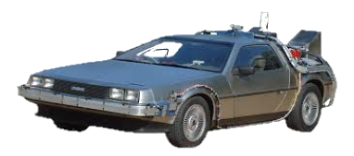
Backpropogation through time (bptt)
The RNN trains its units by adjusting their weights following a slight modification of a feedback process known as backpropogation.
Recurrent neural networks use a heavier version of this process known as backpropogation through time (BPTT). This version extends the tweaking process to include the weight of the T-1 input values responsible for each unit’s memory of the prior moment.

Slide 23
Rnn classifier
A convolution neural network (CNN) is better suited for image classification, however the Geron book provides an example using RNNs to evaluate the MNIST data set.
Surprisingly RNNs produce 98% accuracy without much work.

Slide 24
Times series predictions
The most common example is predicting a stock price.

Slide 25
Vanishing gradients
When training a deep neural network, the larger the gradient, the steeper the slope, the more quickly the system can roll 'downhill' to the finish line and arrive at an optimal solution.
As gradients get smaller and smaller, and thus flatter and flatter, training times grow unbearably long.

Slide 26
Long Short-Term Memory (LSTM)
In the late 90s, a major breakthrough solved the vanishing descent problem.
Long Short-Term Memory (LSTM) gave a second wind to recurrent network development.
LSTMs help preserve the error that can be backpropagated through time and layers. By maintaining a more constant error, they allow recurrent nets to continue to learn over many time steps, and open a channel to link causes and effects remotely.

Slide 27
LSTM Advantages
Perform much better than standard recurrent neural cell.
Training will converge faster.
Ability to detect long-term dependencies in data.
In TensorFlow use BasicLSTMCell instead of BasicRNNCell

Slide 28
Mind the gap
Sometimes, there is only need to look at recent information to perform a task. Consider a language model trying to predict the next word based on the previous ones. Try to predict the last word in “The sky is ___”
Unfortunately, as that gap grows, RNNs become unable to learn to connect the information.
Consider trying to predict the last word in the text “I grew up in France… I speak fluent _____.”

Slide 29
LSTM operation
LSTM cell can learn to recognize an important input.
Store the input in long-term memory.
Implements a 'forget gate' which allows input to be preserved only as long as necessary.
Extracts memory state when necessary.

Slide 30
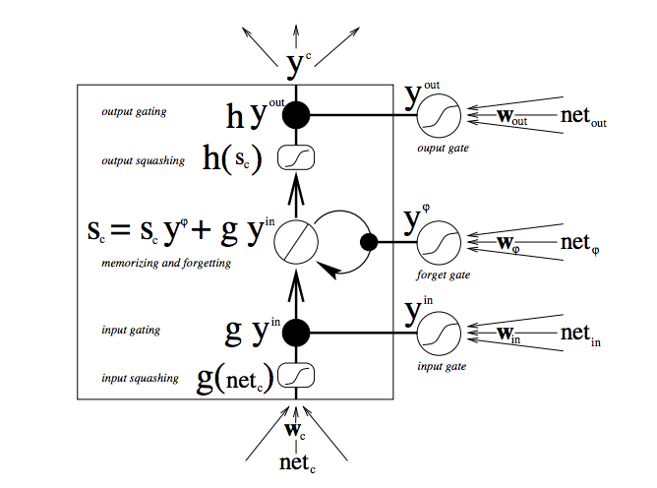
Lstm cell

Slide 31
LSTM input Flow
Starting from the bottom, the triple arrows show where information flows into the cell at multiple points. That combination of present input and past cell state is fed not only to the cell itself, but also to each of its three gates, which will decide how the input will be handled.

Slide 32
Forget gate
Note: TensorFlow initializes the 'forget' bias vector to '1'. This prevents the cell from forgetting everything at the beginning of training.

Slide 33
Peephole connections
In 2000, Felix Gers and Jurgen Schmidhuber proposed a variation of LSTM which provides more 'context' when considering the previous short-term state by providing a 'peephole' (via extra connections) to long-term state.
TensorFlow supports peephole connections:
Tf.contrib.rnn.LSTMCell(use_peepholes=True)

Slide 34
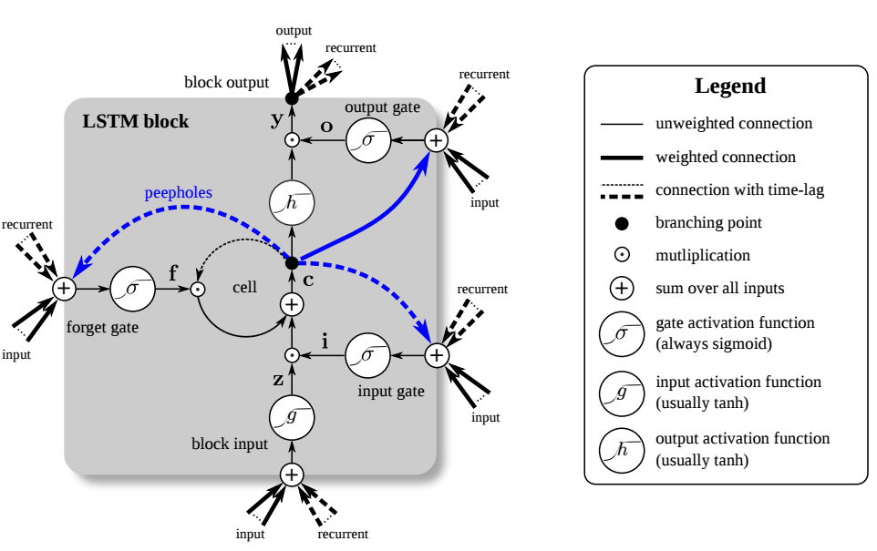

Slide 35
Gated recurrent unit (GRU) cell
Proposed by Kyunghyun Cho in 2014, which also introduced the Encoder/Decoder network topology.
The GRU cell is a simplified version of an LSTM cell.
The GRU cell seems to have similar performance characteristics to the LSTM.

Slide 36
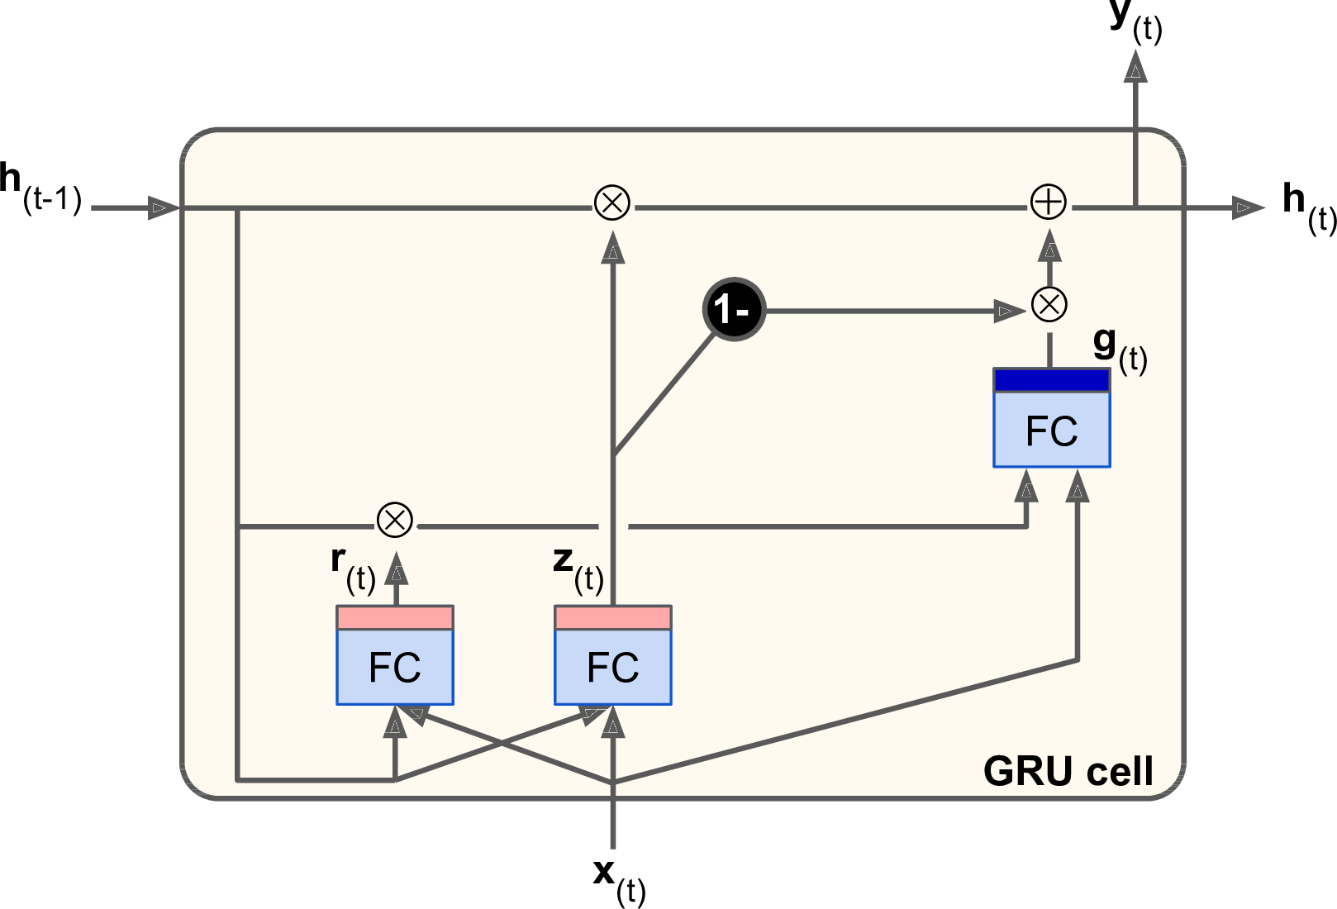
GRU Cell diagram from O'reilly Book

Slide 37
Benchmarking LSTM
Benchmarking of LSTM Networks
Thomas M. Breuel
Google, Inc
https://arxiv.org/pdf/1508.02774.pdf
Generally, how do LSTMs behave for different hyperparameters?
How reproducible are training results based on hyperparameters?
What are the effects of batching and momentum on error rates?
How do different choices of non-linearities affect performance?
Are peepholes useful?
What are the effects of bidirectional methods?
What are the effects of using CTC?

Slide 38
Define: Ctc
Connectionist temporal classification (CTC) is a type of neural network output and associated scoring function, for training recurrent neural networks (RNNs) such as LSTM networks to tackle sequence problems where the timing is variable. It can be used for tasks like on-line handwriting recognition[1] or recognizing phonemes in speech audio. CTC refers to the outputs and scoring, and is independent of the underlying neural network structure. It was introduced in 2006.

Slide 39
CTC Example
The input is a sequence of observations, and the outputs are a sequence of labels, which can include blank outputs. The difficulty of training comes from there being many more observations than there are labels. For example in speech audio there can be multiple time slices which correspond to a single phoneme. Since we don't know the alignment of the observed sequence with the target labels we predict a probability distribution at each time step. A CTC network has a continuous output (e.g. softmax), which is fitted through training to model the probability of a label. CTC does not attempt to learn boundaries and timings: Label sequences are considered equivalent if they differ only in alignment, ignoring blanks. Equivalent label sequences can occur in many ways – which makes scoring a non-trivial task.
CTC scores can then be used with the back-propagation algorithm to update the neural network weights.

Slide 40
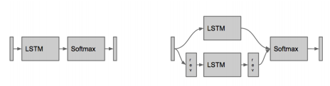
Bidirectional vs. Unidirectional
Unidirectional LSTM layer is followed by a logistic or softmax output layer.
Bidirectional LSTM training, the input sequence is processed both in forward and reverse, and the combined outputs of the forward and reverse processing at each time step are then combined into a final output.

Slide 41
Bidirectional limitation
Bidirectional LSTM networks can take into account both left and right context in making decisions at any point in the sequence, but they have the disadvantage that they are not causal and cannot be applied in real time.
Bidirectional networks have twice the number of internal states and slightly more than twice the number of weights than corresponding unidirectional networks with the same number of states.

Slide 42
CTC vs. Non-CTC
In non-CTC training, the target for LSTM training is constructed by assuming a fixed relationship between the images of input symbols and the appearance of the symbol in the output sequence. In CTC training, the target for LSTM training is constructed by aligning (using the forward-backward algorithm) the target sequence with the actual output of the LSTM.
(see diagram next slide)

Slide 43
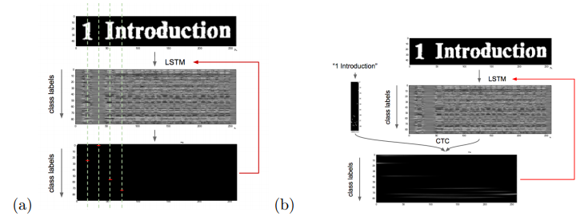
CTC vs. Non-CTC (cont.)

Slide 44
Results
LSTM networks give excellent performance on MNIST digit recognition; this also represents a simple and useful test case for checking whether an LSTM implementation is performing correctly.
LSTM networ k performance is fairly reproducible between training runs and test set error has broad flat minima in hyperparameter space (i.e., hyperparameter optimization is fairly simple).
The best performing networks in all experiments were “standard” LSTM networks with no peephole connections.

Slide 45
Results (cont.)
Peephole connections never resulted in any improved performance.
Momentum and batchsize parameters had no observable effect on LSTM performance; this means that batching may often be a good method for parallelizing LSTM training.
LSTM networks failed to converge to low error rate solutions with logistic outputs and MSE training for the OCR task; softmax training resulted in the lowest error rates overall.
CTC and bidirectional networks generally perform better than fixed outputs and/or unidirectional networks.
LSTM test set error rates seem to invariably diverge eventually.

Slide 46
The rise of 'attention-based' models
RNN/LSTM systems require more resources to train and run than attention-based models.
RNN's are not 'hardware friendly'- especially when processing has to be done on an 'edge' device.
LSTM can remember sequences of 100s. Not 1000s or 10,000s or more.

